Slide 1
Yoneda Embeddings
Chapter 16

Slide 2
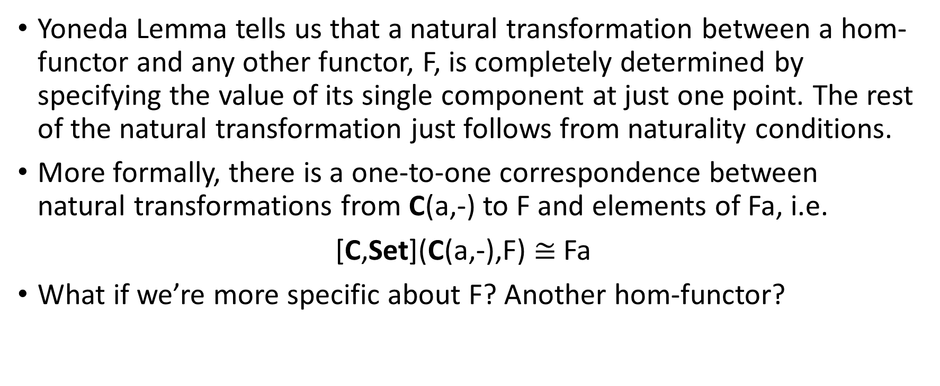
Recap – Yoneda Lemma
Yoneda Lemma tells us that a natural transformation between a hom-functor and any other functor, F, is completely determined by specifying the value of its single component at just one point. The rest of the natural transformation just follows from naturality conditions.
More formally, there is a one-to-one correspondence between natural transformations from C(a,-) to F and elements of Fa, i.e.
[C,Set](C(a,-),F) $≅$Fa
What if we’re more specific about F? Another hom-functor?

Slide 3
Motivation
Consider the mapping M: a -> C(a,-) for all objects a in C.
This takes objects in C and maps them to objects in the functor category, since C(a,-) is a functor (i.e. the hom-functor).
Recall the functor category is the category of functors from one category to another (in this case C and Set, denoted [C,Set]).
Is M a functor between C and [C,Set]?
How does M treat morphisms in C? They will need to be mapped to morphisms in [C,Set], which are natural transformations.

Slide 4
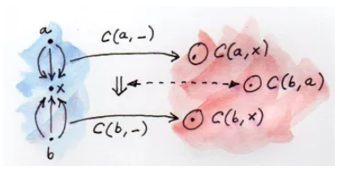
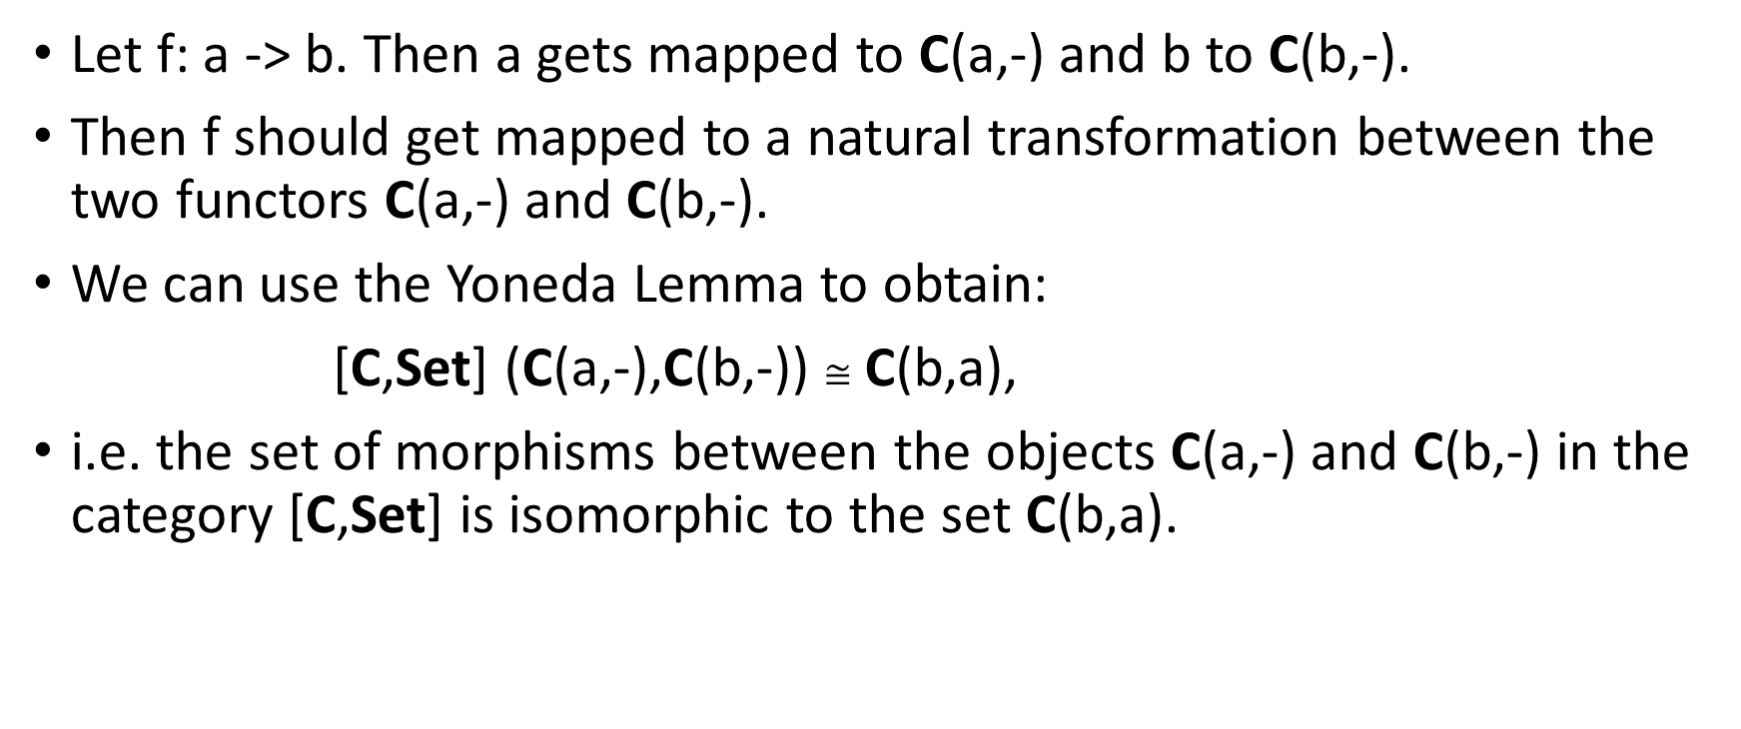
Motivation (cont.)
Let f: a -> b. Then a gets mapped to C(a,-) and b to C(b,-).
Then f should get mapped to a natural transformation between the two functors C(a,-) and C(b,-).
We can use the Yoneda Lemma to obtain:
[C,Set] (C(a,-),C(b,-)) $≅$ C(b,a),
i.e. the set of morphisms between the objects C(a,-) and C(b,-) in the category [C,Set] is isomorphic to the set C(b,a).

Slide 5
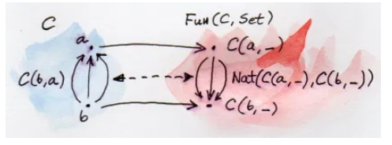
Motivation (cont.)
The Yoneda Lemma tells us that this mapping from morphisms in C to [C,Set] exists, i.e. each morphism in C can be mapped to a natural transformation in [C,Set] in a sensible way.
Thus, M :: a -> C(a,-) is a functor.
Moreover, it is fully faithful, i.e.
Injective on hom-sets (maps distinctive morphisms to distinctive morphisms).
Surjective on hom-sets (maps one hom-set onto the other hom-set).
Thus, for every pair of objects, a, b in C there is a bijection between C(a,b) and [C,Set](C(a,-),C(b,-)]

Slide 6
Embedding
The functor M:: a -> C(a,-) is defined as the Yoneda embedding.
It embeds a category C into [C,Set].
We know a lot about [C,Set], i.e. the Category of Functors (from C to Set).
We can get a lot of insight about an arbitrary category C by embedding it into the functor category.

Slide 7

Preorder Example
A set with a preorder, ≤, gives a category.
Objects are elements of this set.
Morphism from a to b means a ≤ b.
At most one morphism between two objects. Thus, any hom-set is either empty or a one-element set.
Apply co-Yoneda i.e,
The Hom-set on the RHS is non-empty iff a ≤ b, in which case it’s a one-element set. Consequently, if a ≤b there exists a single Natural Transformation between the functor C(-,a) and C(-,b).

Slide 8
Preorder Example (cont.)
Natural transformation will never connect singleton hom-set to an empty hom-set.
In other words, if x ≤ a (singleton hom-set C(x,a)) then C(x,b) cannot be empty. A non-empty C(x,b) means that x is less than or equal to b. So the existence of the natural transformation requires that for every x, if x ≤ a then x ≤ b.
Co-Yoneda tells us the existence of this natural transformation is equivalent to C(a,b) being non-empty, i.e. a ≤b.
Together we get a ≤b iff for all x, x ≤a implies x ≤ b.

Slide 9
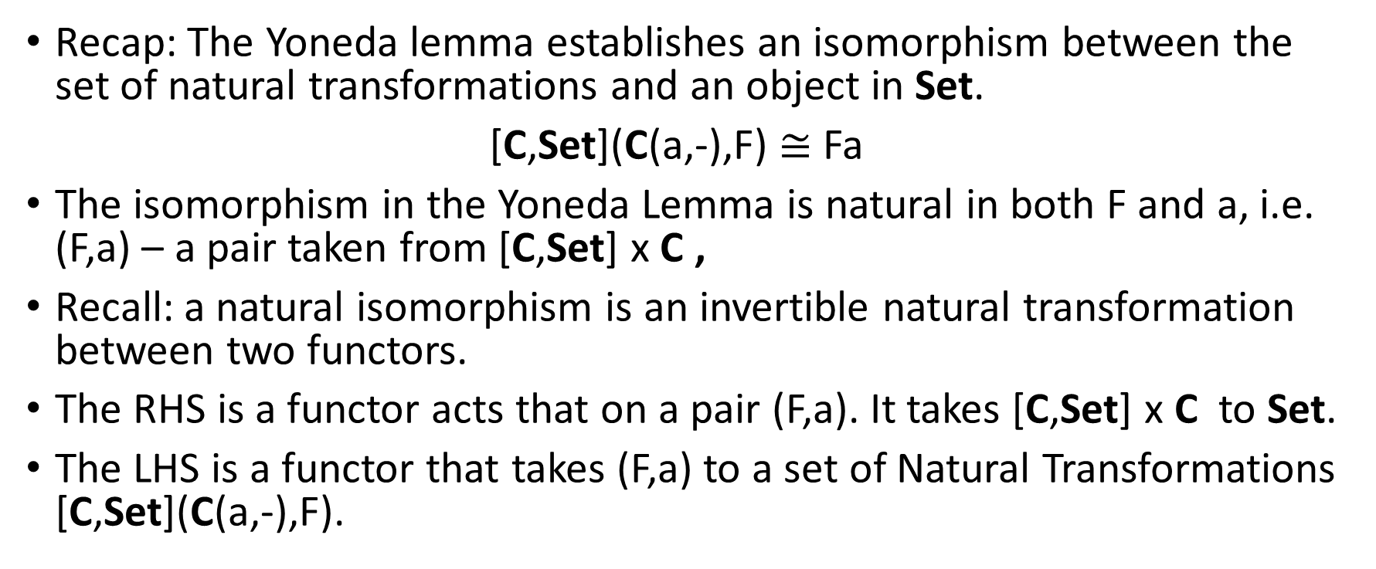
Naturality
Recap: The Yoneda lemma establishes an isomorphism between the set of natural transformations and an object in Set.
[C,Set](C(a,-),F) $≅$ Fa
The isomorphism in the Yoneda Lemma is natural in both F and a, i.e. (F,a) – a pair taken from [C,Set] x C ,
Recall: a natural isomorphism is an invertible natural transformation between two functors.
The RHS is a functor acts that on a pair (F,a). It takes [C,Set] x C to Set.
The LHS is a functor that takes (F,a) to a set of Natural Transformations [C,Set](C(a,-),F).

Slide 10

Challenges – Q1
Express the co-Yoneda embedding in Haskell

Slide 11
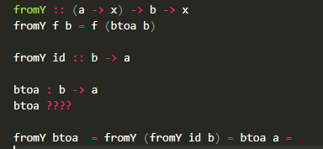
Challenges – Q2(?)
If there is an isomorphism between the functions fromY and btoa then the mappings are inverses, i.e. fromY btoa = Id = btoa fromY
Got this far:

Slide 12
Challenges – Q3
Yoneda embedding for a Monoid (Category with one object)
Let the single object be denoted m.
Yoneda embedding maps the object to functor C(m,-) in the Functor Category denoted [C,Set]. In this case, the functor C(m,-) will map the single object m to the hom-set C(m,m)
Each morphism in the monoid will be mapped to a natural transformation in the Functor Category, [C,Set].
Since the structure has to be preserved, the morphisms will be mapped to natural transformations from the functor C(m,-) to itself.
What else? Well, the embedding functor is fully faithful, which means the morphisms will be mapped to distinct morphisms and cover the hom-set in the target category. In particular, there is a bijection between the morphisms in the monoid and the natural transformations from C(a,-) to itself.

Slide 13
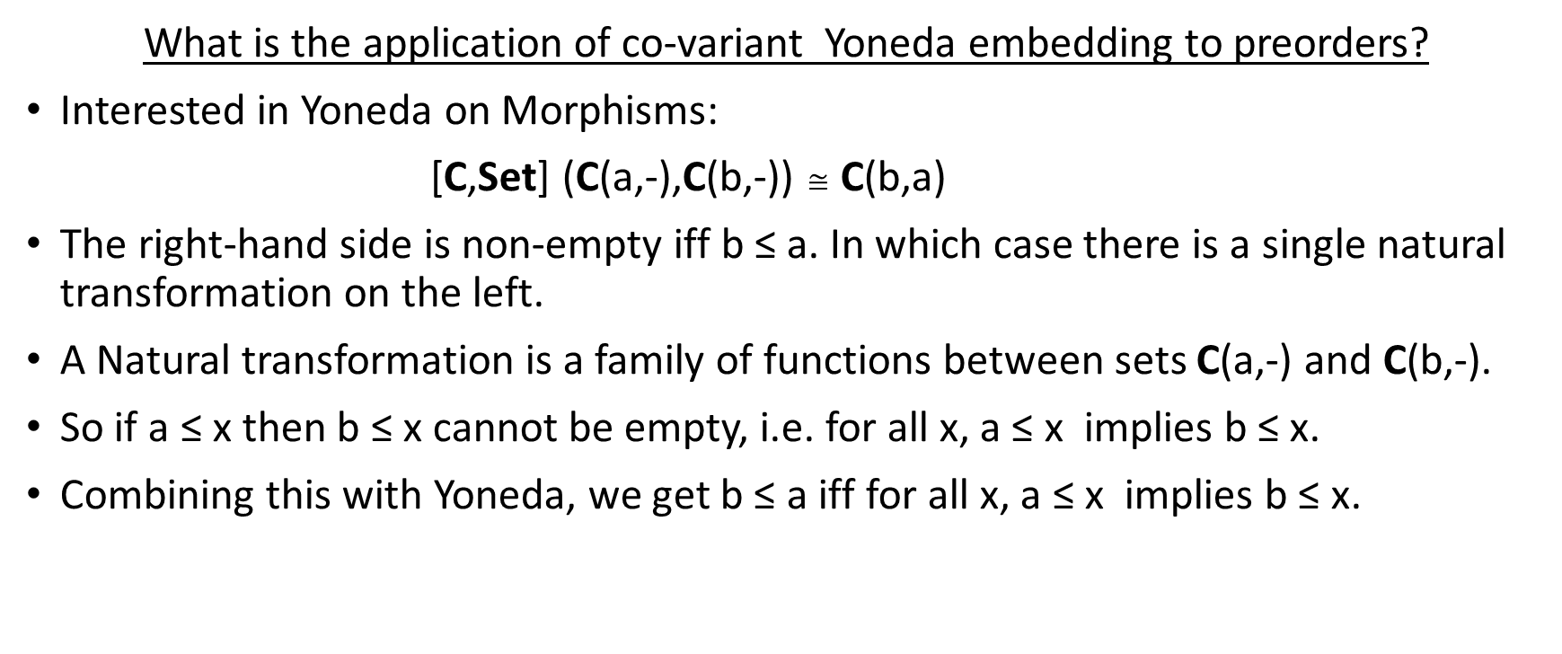
Challenges – Q4
What is the application of co-variant Yoneda embedding to preorders?
Interested in Yoneda on Morphisms:
[C,Set] (C(a,-),C(b,-)) $≅$ C(b,a)
The right-hand side is non-empty iff b ≤ a. In which case there is a single natural transformation on the left.
A Natural transformation is a family of functions between sets C(a,-) and C(b,-).
So if a ≤ x then b ≤ x cannot be empty, i.e. for all x, a ≤ x implies b ≤ x.
Combining this with Yoneda, we get b ≤ a iff for all x, a ≤ x implies b ≤ x.

Slide 14
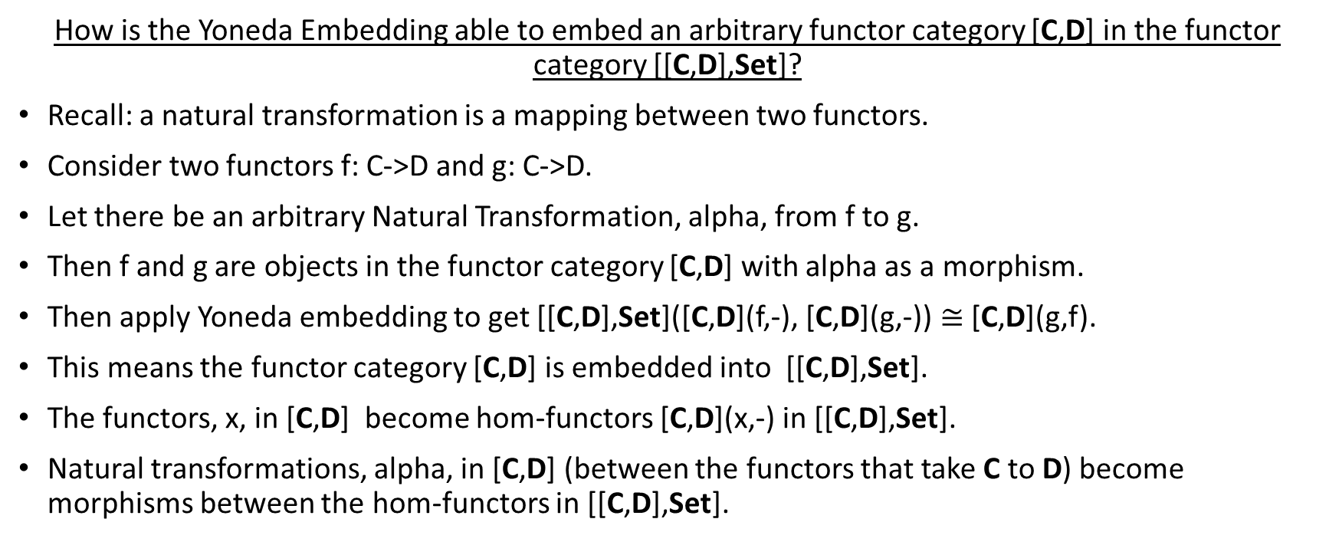
Challenges – Q5
How is the Yoneda Embedding able to embed an arbitrary functor category [C,D] in the functor category [[C,D],Set]?
Recall: a natural transformation is a mapping between two functors.
Consider two functors f: C->D and g: C->D.
Let there be an arbitrary Natural Transformation, alpha, from f to g.
Then f and g are objects in the functor category [C,D] with alpha as a morphism.
Then apply Yoneda embedding to get [[C,D],Set]([C,D](f,-), [C,D](g,-)) $≅$ [C,D](g,f).
This means the functor category [C,D] is embedded into [[C,D],Set].
The functors, x, in [C,D] become hom-functors [C,D](x,-) in [[C,D],Set].
Natural transformations, alpha, in [C,D] (between the functors that take C to D) become morphisms between the hom-functors in [[C,D],Set].

